Slide 1
CP1404 Module 5B Code Reviews

Slide 2
Code reviews improve software quality
A code review is a systematic examination or peer review of code
Goals:
find and fix mistakes
improve the overall quality of software
improve the developers' skills (both parties)
Reviews are done in various forms:
pair programming
informal walkthroughs
formal inspections
and to a lesser extent, self-reviewing

Slide 3
Code reviews often find common mistakes
Google's checklist for Python code: https://code.google.com/p/rad2py/wiki/CodeReview
Code review guide for the Go programming language: https://github.com/golang/go/wiki/CodeReviewComments
It’s good to learn the "idiomatic" (best-practice) way of doing things in any language; and the preferred way for any team you’re part of
Use common mistakes/checklists to learn what to avoid
Try and write code that doesn’t make the usual mistakes

Slide 4
What's important?
While the process (use branches, open a PR, make line comments, etc.) is important... What really matters is the reviewing
Reviewers don't just make trivial or "all good" comments, but really look for what could be improved
Reviewing other people's code helps you write better code

Slide 5
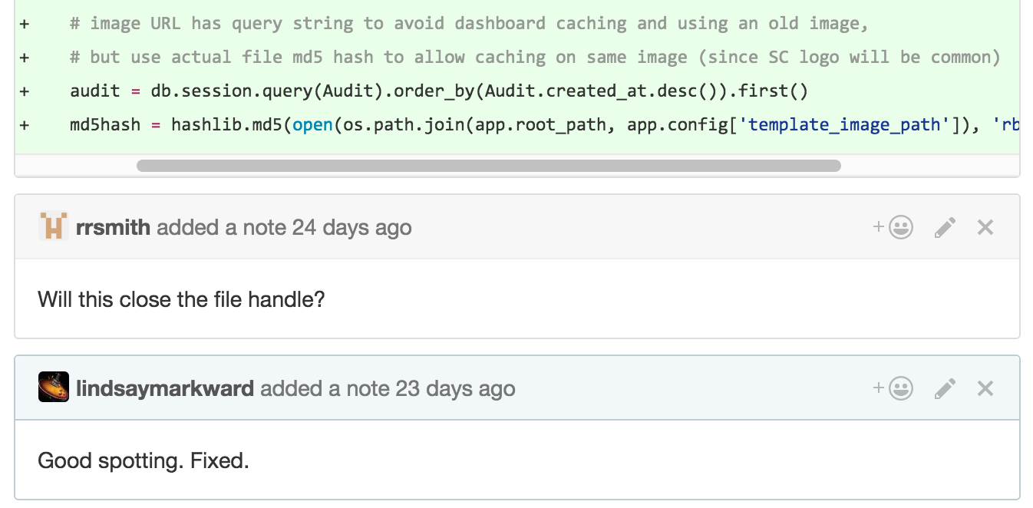
Can you see what's wrong with Lindsay's code?
Notes:
Note the friendly nature of the review comment - posed as a question (when the reviewer probably knew the answer).
Note also that this is a great case for a block comment, since the code is not obvious on its own.

Slide 6
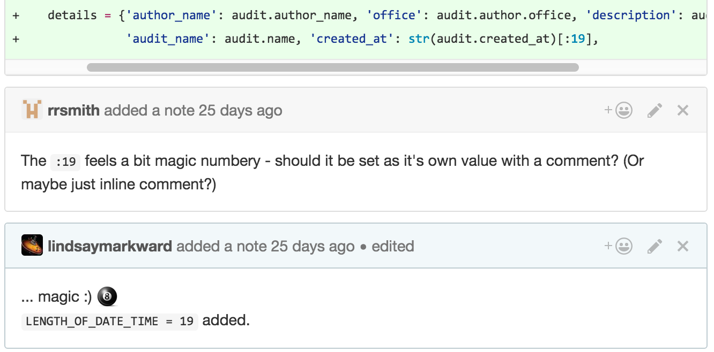
Be nice when reviewing. Nice is good.
Note how the reviewer is not giving instructions but questions and suggestions (nice tone of voice)!

Slide 7
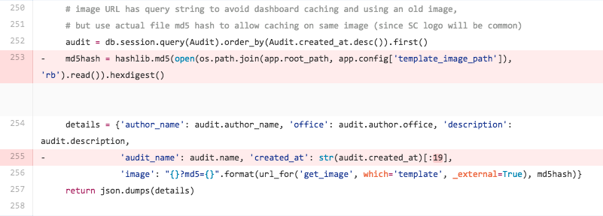
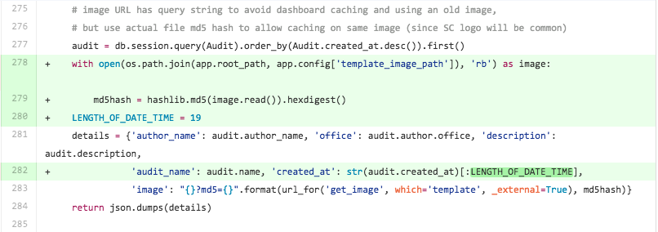
Peer reviews lead to better code and skills ☺
File opened using with (closes automatically)
19 replaced by a more meaningful named constant
Example 1
Example 2

Slide 8
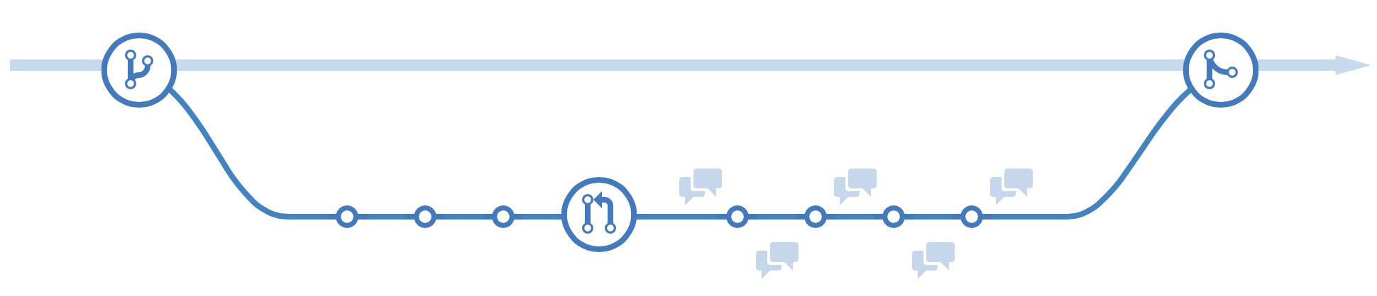
Version control helps with code reviews
One of the best ways to do a code review is with a Pull Request (PR) on GitHub
This can be done using:
a branch within the same repo
or a fork, a separate copy of the repository owned by someone else
Notes:
https://help.github.com/articles/using-pull-requests
Another brilliant resource is: https://www.atlassian.com/git/

Slide 9


Use a fork for editing another person's repo
Fork an existing GitHub repo
This is just a clone (copy), but GitHub tracks it
Modify the code in your new repo
Commit and push your changes
Send a pull request to the original repo
The owner of the original checks to see differences and can merge the pull request into the original repo
They could use all or only some parts of the pull request
(optionally, delete cloned repo)
Example: https://github.com/ninjasphere/go.wemo/pull/1
Notes:
The example is very simple, but is Lindsay's first PR to an open source project.

Slide 10
Teams often use PR code reviews to build software
Original developer creates a git branch with the issue number (e.g., EAG-123) of what they're working on
They commit to that branch, messages start with that issue number, e.g. “[EAG-123] add support for X”
When finished, they open a PR for that branch into master
Developer assigns the issue to another developer to review
Then the reviewer git fetches and checks out that branch, then tests and reviews it
Reviewer adds comments to the PR
Developer does more commits (which updates the PR)
When finished, the reviewer then merges the branch
Notes:
Steps 6-7 are a cycle, until finished reviewing/commenting/updating

Slide 11
Here's our simplified version of this
Create a new feedback branch in your practicals repo
Develop and commit to that branch
When finished, open a PR for that branch into master
@mention another developer in PR to review
Reviewer adds comments to the PR
Optionally: Developer does more commits (this updates the PR)
When finished, the developer then merges the branch in GitHub
(Then delete the feedback branch and create it again as needed.)
Notes:
One reason for the difference is that this way we don't need to add collaborators or share GitHub access. Anyone can add comments.

